Slide 1


Bread and JAMs With Tony
July, 2020

Slide 2
WHAT?

Slide 3


What
This is jam
This should be JAMstack ??

Slide 4
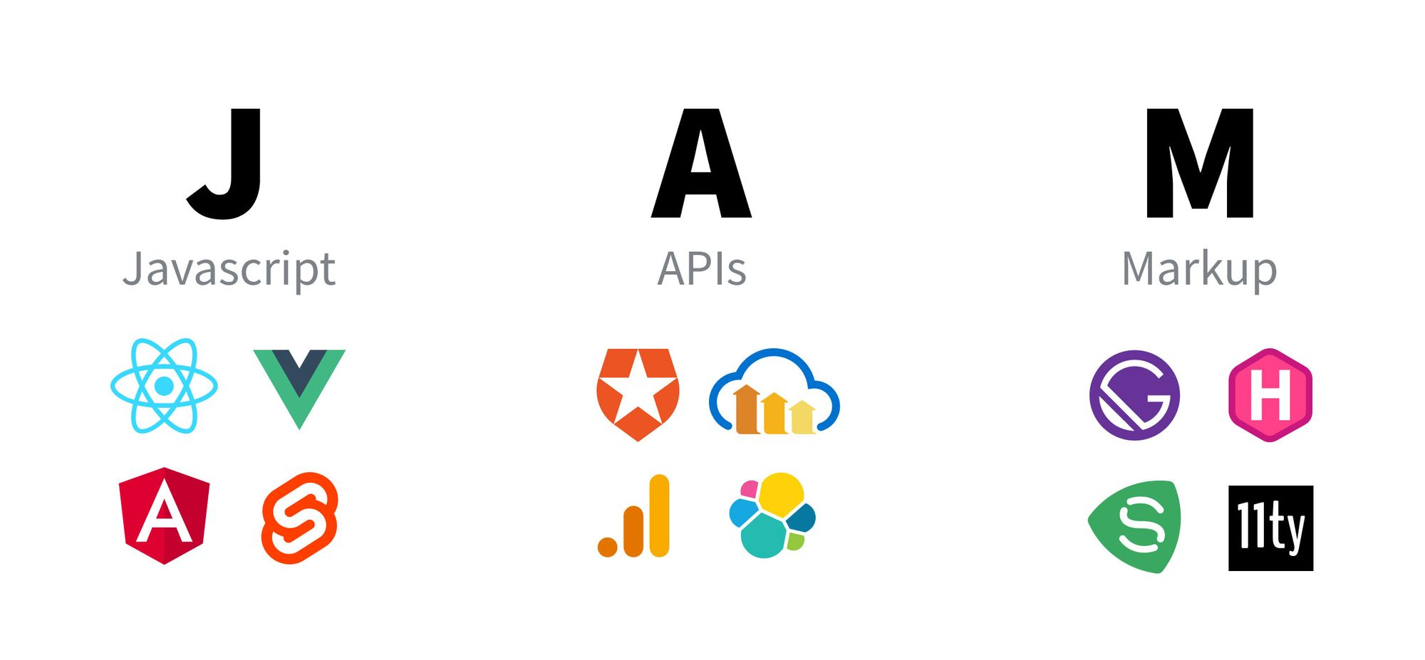
What

Slide 5
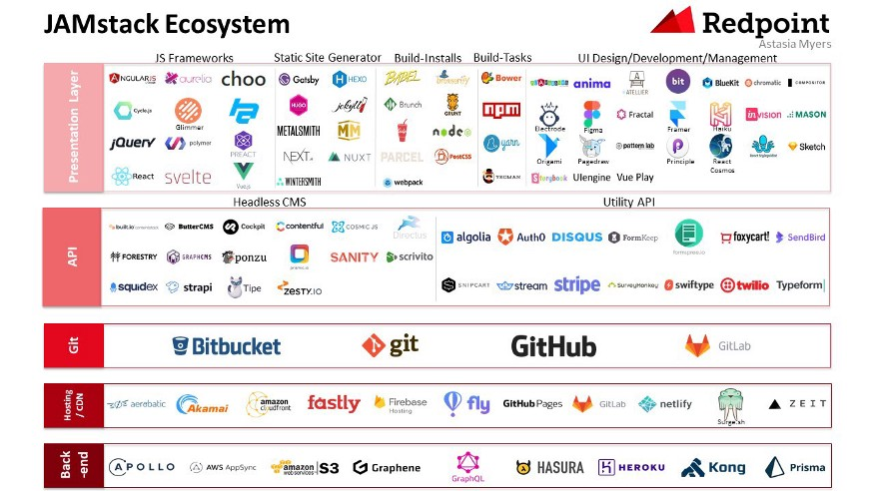
What

Slide 6
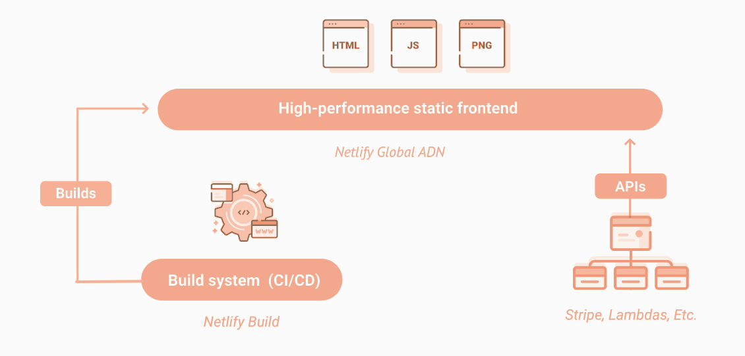
What
Decoupling the frontend from the backend

Slide 7
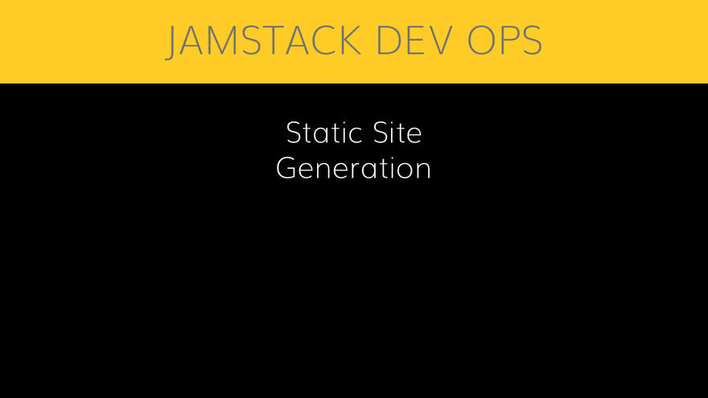
What
2. Prebuilding all pages for speed

Slide 8
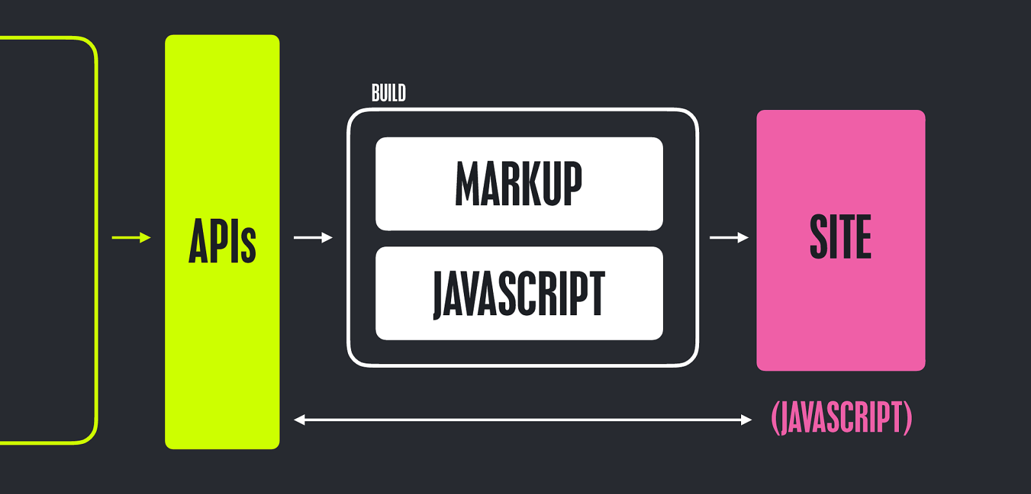
What
3. Dynamic content via APIs

Slide 9
What
Limitation
Not great with heavy, dynamic features
Highly dependent on third-party systems

Slide 10
WHY?

Slide 11
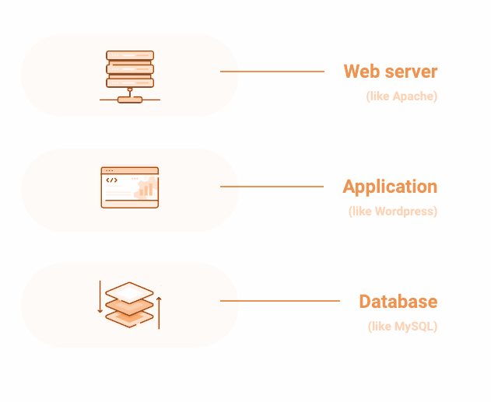
Why
The problem with the legacy web
Complex apps and complex servers
It can be outdated and slow down
Expensive to scale up
Open opportunities for attack

Slide 12
Why
What is JAMstack benefit?
Faster websites
More secure infrastructure
High scale without high complexity
Improved developer experience

Slide 13

Why
What is JAMstack benefit?
Speed
Optimize your site with prerendering and global delivery via CDN.
JAMstack website is blazing faster. Better speed, better SEO.

Slide 14

Why
What is JAMstack benefit?
Stability
Without complex server applications and databases, resulting in a very stable architecture.

Slide 15

Why
What is JAMstack benefit?
Scalability
The cost to scale a Jamstack website or application is significantly less versus a database-driven website.

Slide 16
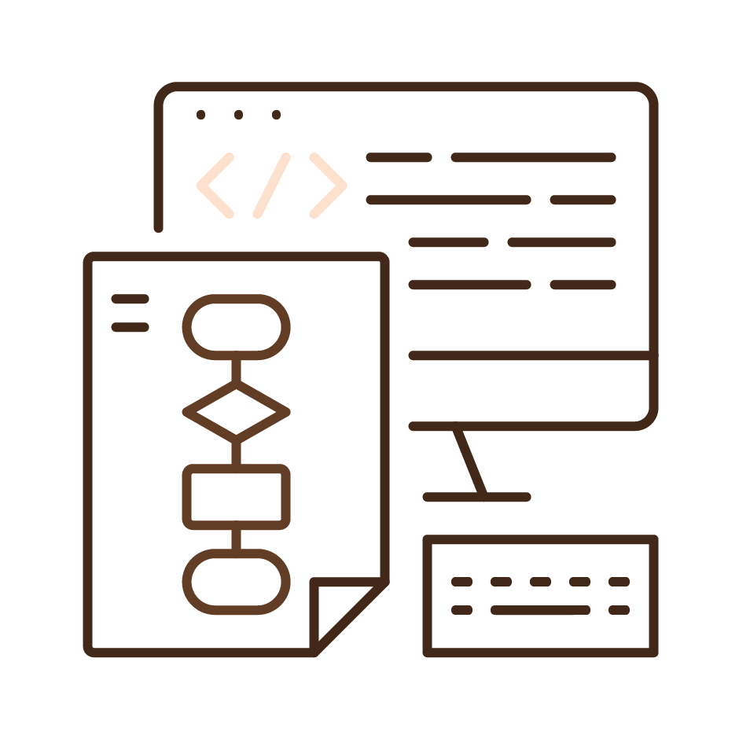
Why
What is JAMstack benefit?
By design, Jamstack architectures offer fewer points of attack.
Security

Slide 17

Why
What is JAMstack benefit?
Better developer experience
Front end developers can focus on the front end, without being tied to a monolithic architecture.
This usually means quicker and more focused development

Slide 18
HOW?

Slide 19
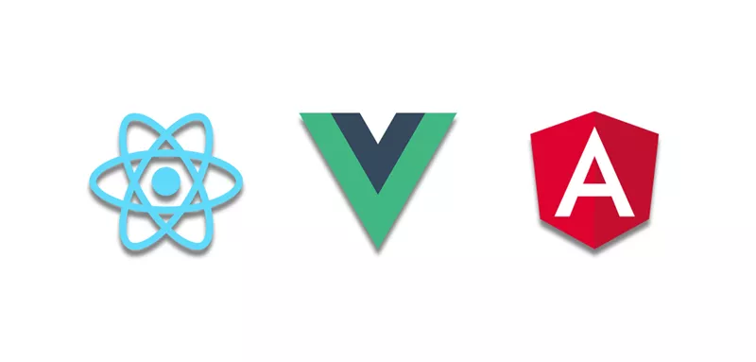
HOW
Choose a JS FE framework
The Holy Trinity of JavaScript frameworks is React, Vue & Angular.

Slide 20
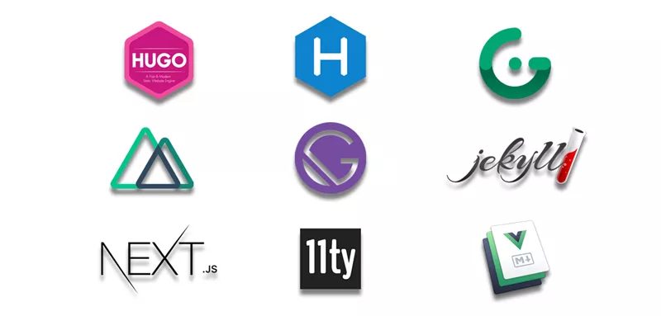
HOW
2. Choose a Static site generators
These are powerful static site generator. You can choose one to start with you framework.
Gatsby & Next.js for React, Nuxt & Gridsome for Vue

Slide 21
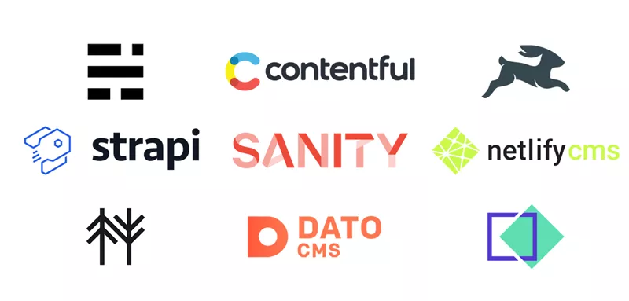
HOW
3. Choose a Headless CMS
Content Management Systems are really great for a few things: - manage user permissions - editor roles and, - obviously, content.

Slide 22
HOW
4. Choose a way to deploy
Your built site needs to be hosted somewhere. There are great services that provides this for free and with ease.
Netlify
Vercel
Github Pages
Stackbit

Slide 23
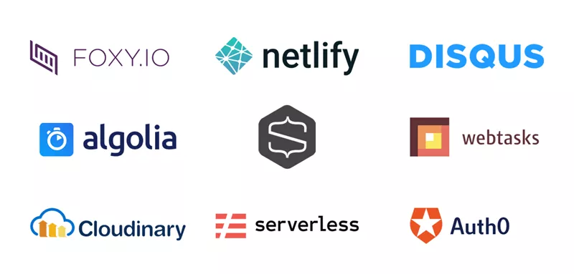
HOW
5. Add Dynamic parts
The current API economy and explosion in SaaS offers an interesting à la carte approach.

Slide 24
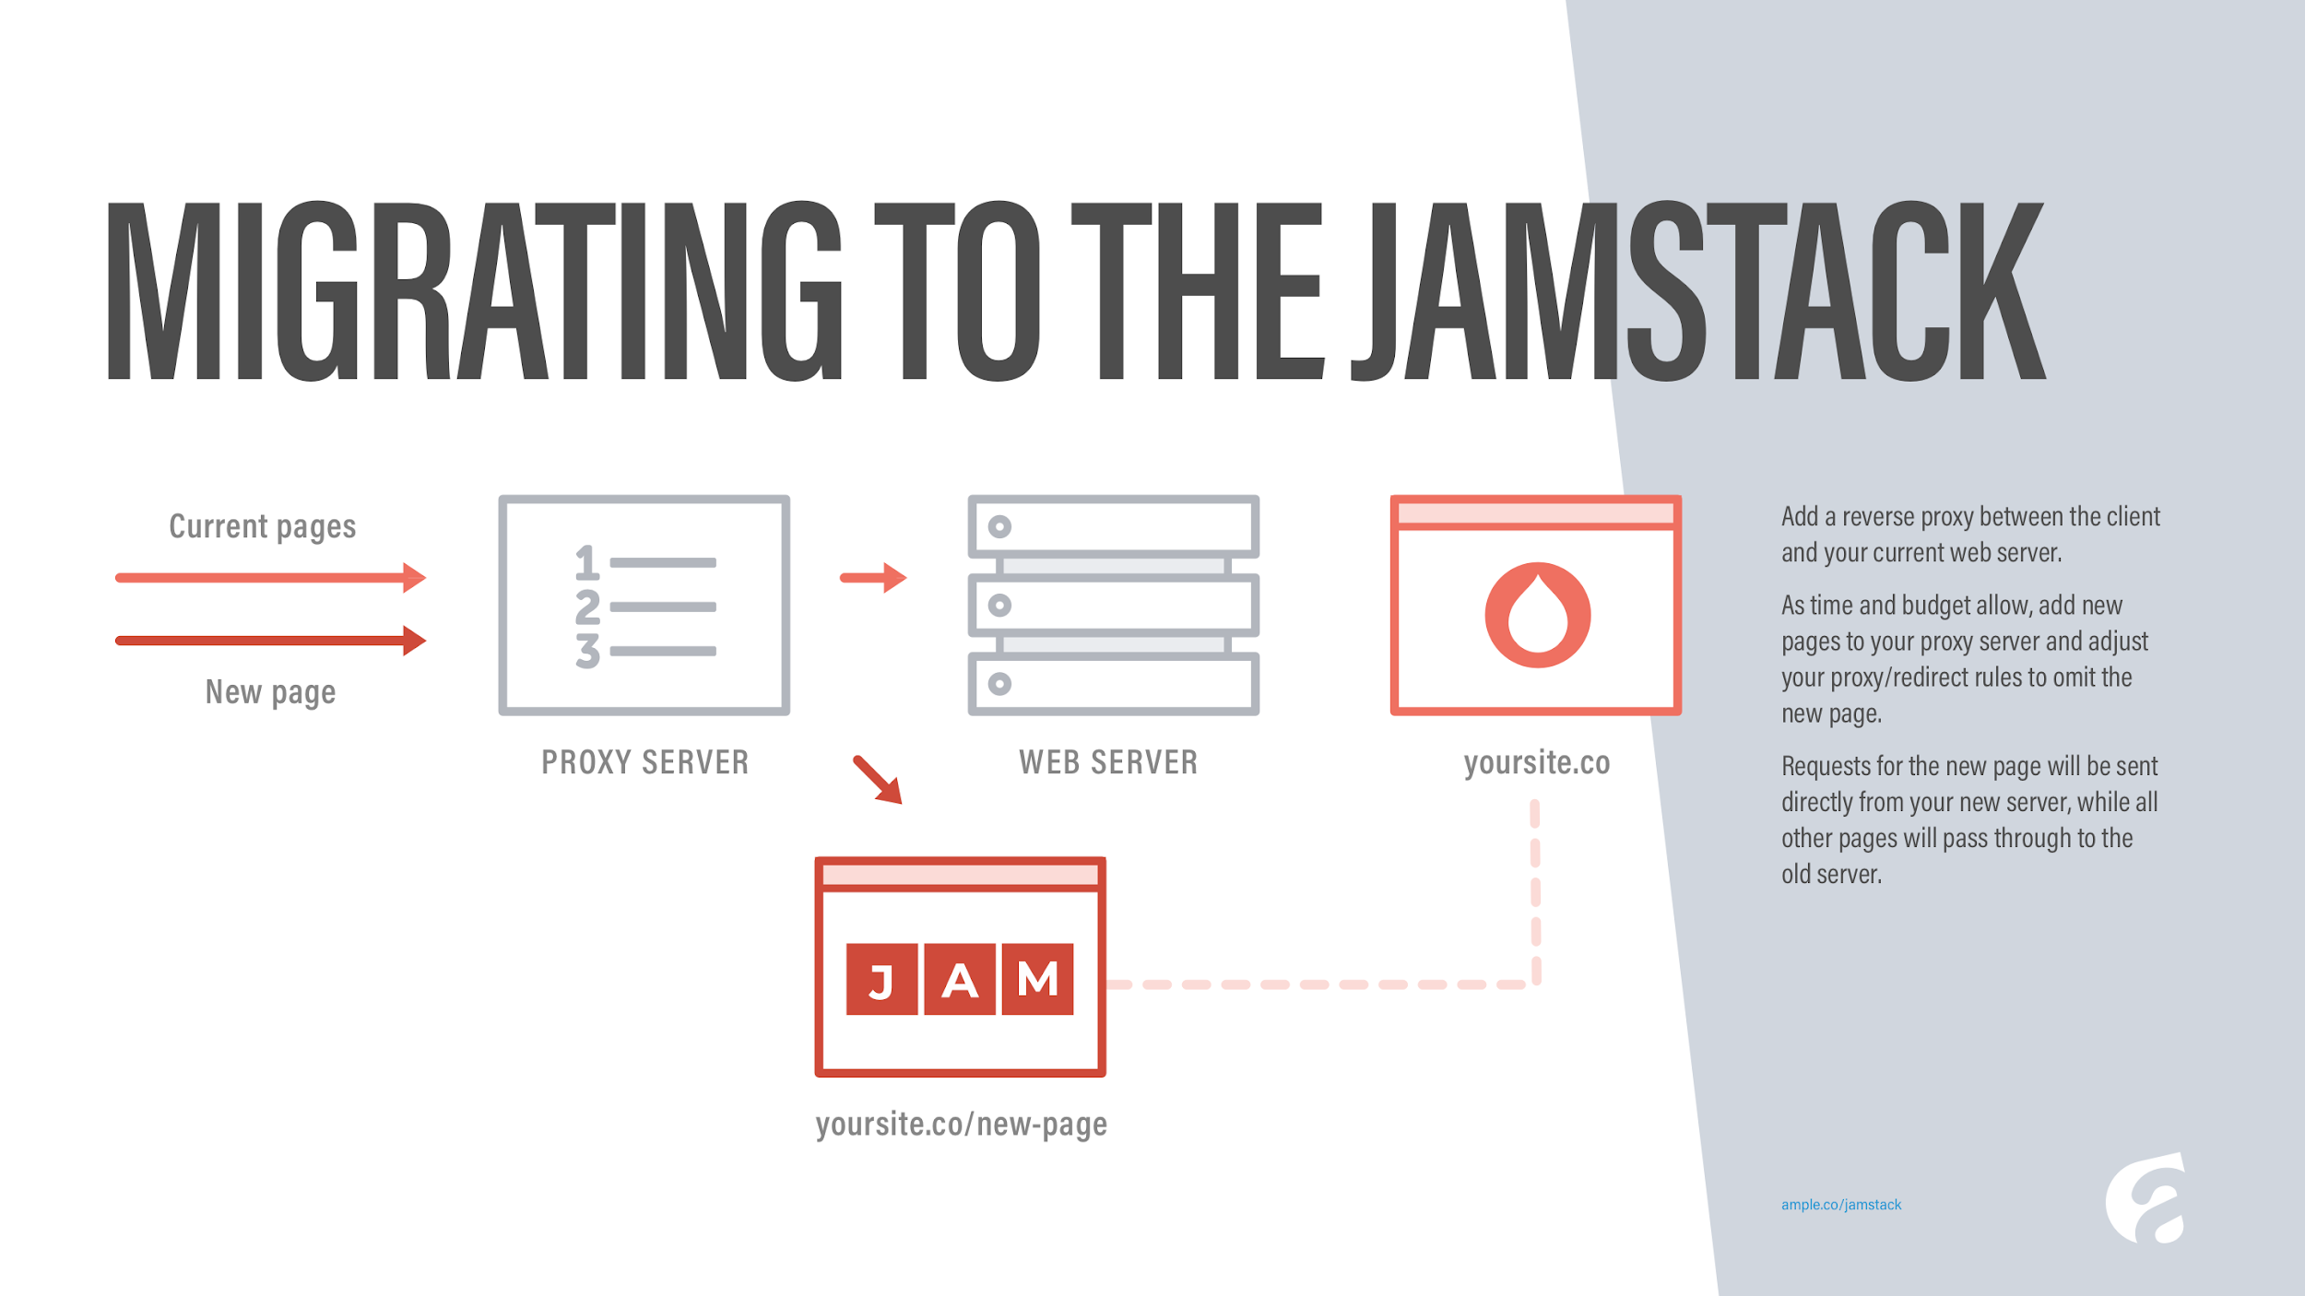
HOW
Migrate

Slide 25

HOW
MAKE THE CLIENT FEEL IT

Slide 26
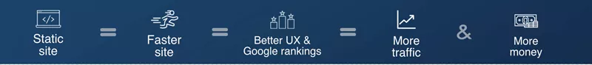
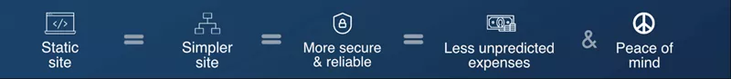
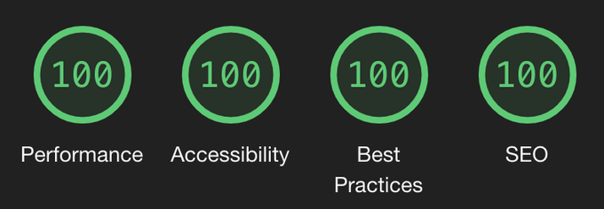
HOW
MAKE THE CLIENT FEEL IT
Supermaya scores 100% on Lighthouse tests.

Slide 27
Q&A

Slide 28
REFERENCE

Slide 29
REF
https://snipcart.com/blog/jamstack
https://www.luminary.com/blog/benefits-of-the-jamstack
https://jamstack.wtf/#development
https://agilitycms.com/resources/posts/migrate-to-jamstack-now-no-excuses
https://medium.com/@gianfranconuschese/the-jamstack-return-of-the-server-side-rendering-5a1313dafc92
https://medium.com/memory-leak/the-jamstack-its-pretty-sweet-e0834e4e6bb7
https://agilitycms.com/resources/posts/migrate-to-jamstack-now-no-excuses

Slide 30
THANK YOU
Any concerns or question, feel free to contact at tin.nguyen@nfq.asia

